Slide 1
Hands-on Machine Learning with Spark
Yushu Yao
UC Berkeley

Slide 2
Clustering

Slide 3
Why

Slide 4
Why
finding representatives for homogeneous groups
finding “natural clusters” and describe their unknown properties
finding unusual data objects

Slide 5
K-Means

Slide 6
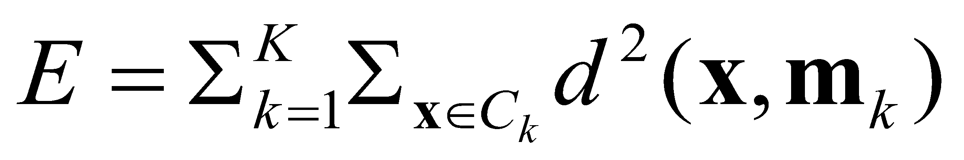
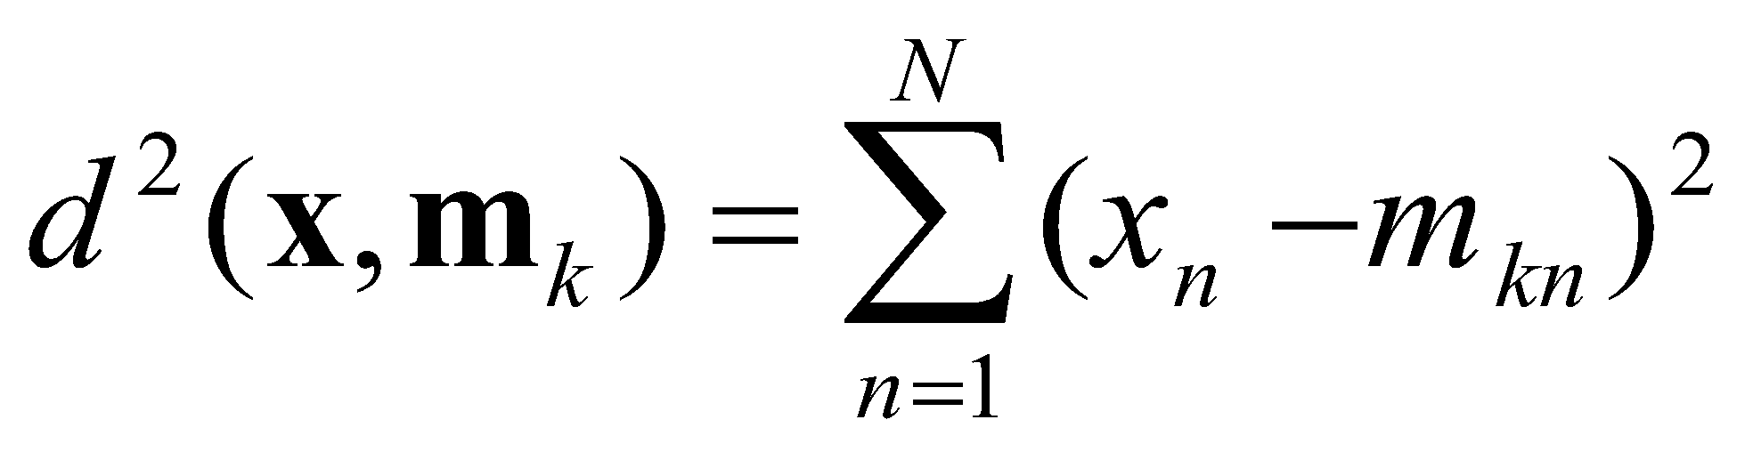
Introduction
Partitioning Clustering Approach
a typical clustering analysis approach via iteratively partitioning training data set to learn a partition of the given data space
learning a partition on a data set to produce several non-empty clusters (usually, the number of clusters given in advance)
in principle, optimal partition achieved via minimising the sum of squared distance to its “representative object” in each cluster
e.g., Euclidean distance
‹#›
Notes:
‹#›

Slide 7
K-means Algorithm
Given the cluster number K, the K-means algorithm is carried out in three steps after initialisation:
Initialisation: set seed points (randomly)
Assign each object to the cluster of the nearest seed point measured with a specific distance metric
Compute seed points as the centroids of the clusters of the current partition (the centroid is the centre, i.e., mean point, of the cluster)
Go back to Step 1), stop when no more new assignment (i.e., membership in each cluster no longer changes)
‹#›
Notes:
‹#›

Slide 8
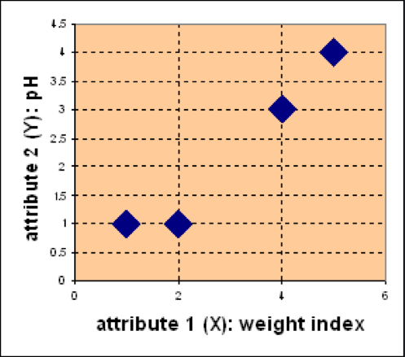
Example
Problem
Suppose we have 4 types of medicines and each has two attributes (pH and
weight index). Our goal is to group these objects into K=2 group of medicine.
D
Medicine | Weight | pH-Index
A | 1 | 1
B | 2 | 1
C | 4 | 3
D | 5 | 4
C
A
B
‹#›
Notes:
‹#›

Slide 9
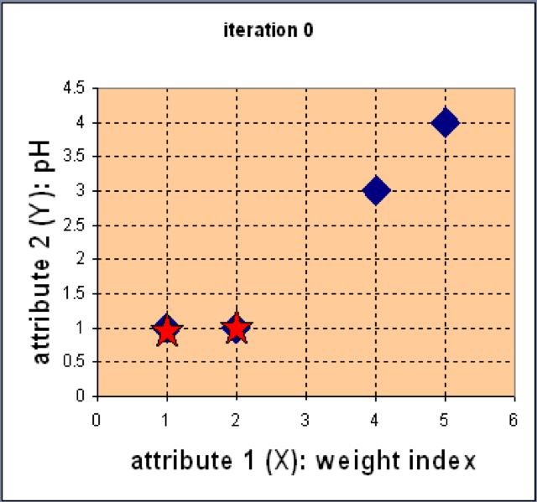
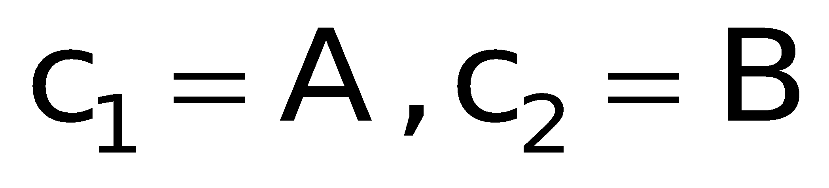
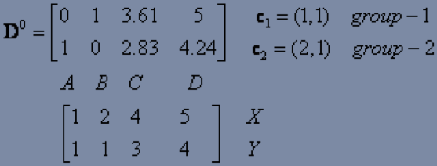
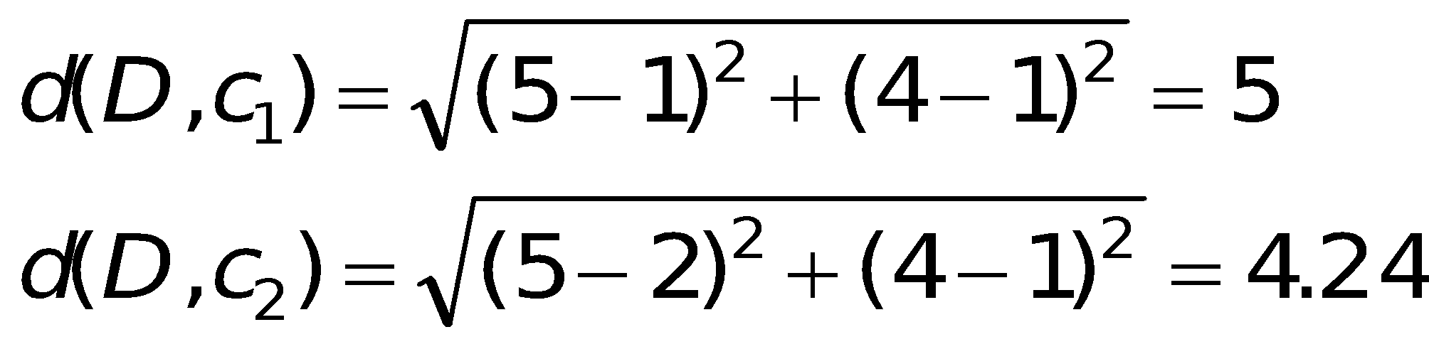
Example
Step 1: Use initial seed points for partitioning
D
C
Euclidean distance
A
B
Assign each object to the cluster with the nearest seed point
‹#›
Notes:
‹#›

Slide 10
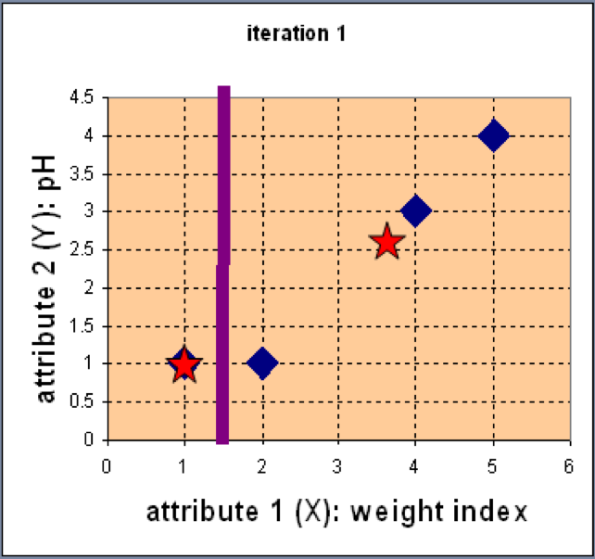
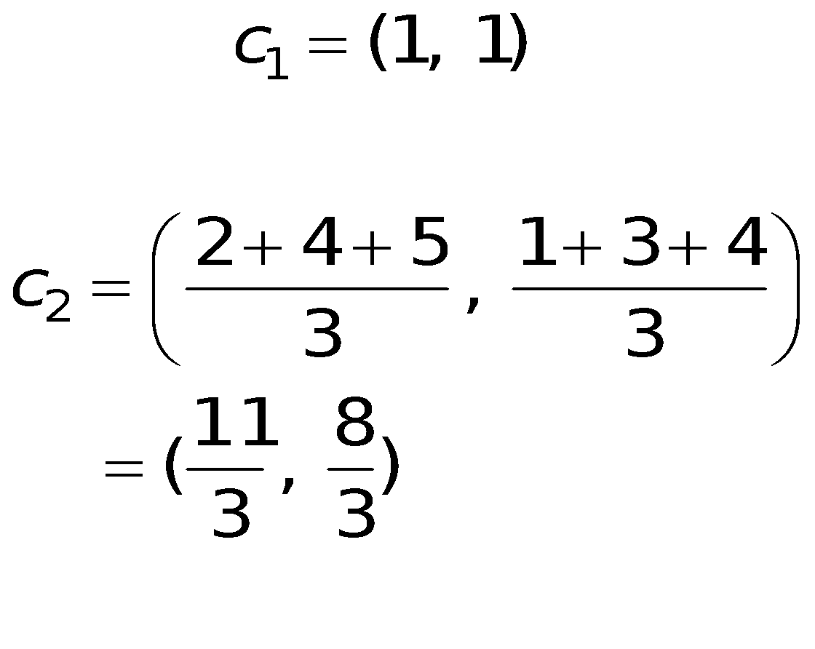
Example
Step 2: Compute new centroids of the current partition
Knowing the members of each
cluster, now we compute the new
centroid of each group based on
these new memberships.
‹#›
Notes:
‹#›

Slide 11
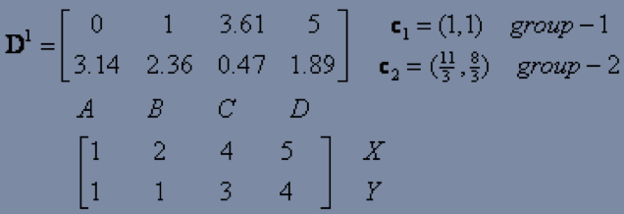
Example
Step 2: Renew membership based on new centroids
Compute the distance of all objects to the new centroids
Assign the membership to objects
‹#›
Notes:
‹#›

Slide 12
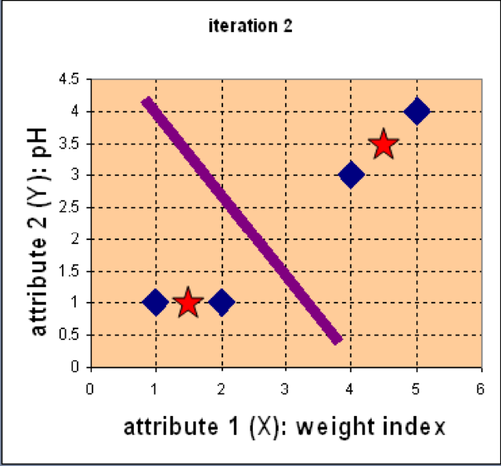
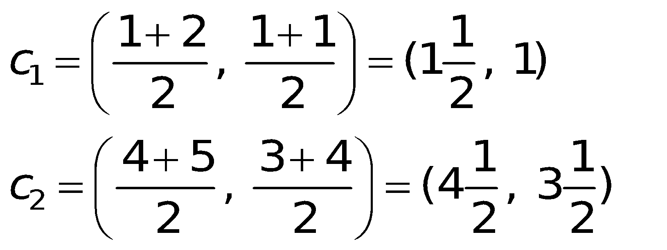
Example
Step 3: Repeat the first two steps until its convergence
Knowing the members of each
cluster, now we compute the new
centroid of each group based on
these new memberships.
‹#›
Notes:
‹#›

Slide 13
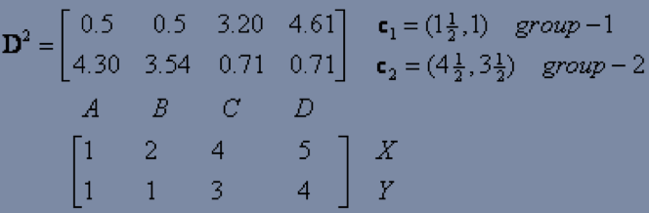
Example
Step 3: Repeat the first two steps until its convergence
Compute the distance of all objects to the new centroids
Stop due to no new assignment
Membership in each cluster no longer change
‹#›
Notes:
‹#›

Slide 14
Exercise Offline
For the medicine data set, use K-means with the Manhattan distance
metric for clustering analysis by setting K=2 and initialising seeds as
C1 = A and C2 = C. Answer three questions as follows:
How many steps are required for convergence?
What are memberships of two clusters after convergence?
What are centroids of two clusters after convergence?
D
Medicine | Weight | pH-Index
A | 1 | 1
B | 2 | 1
C | 4 | 3
D | 5 | 4
C
A
B
‹#›
Notes:
‹#›

Slide 15
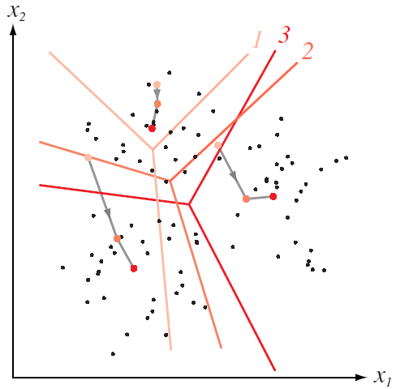
How K-means partitions?
When K centroids are set/fixed,
they partition the whole data space into K mutually exclusive subspaces to form a partition.
A partition amounts to a
Changing positions of centroids leads to a new partitioning.
Voronoi Diagram
‹#›
Notes:
‹#›

Slide 16
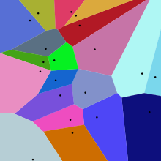
Voronoi Diagram

Slide 17
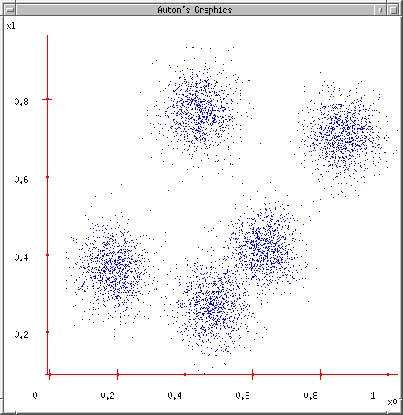
K-means Demo
User set up the number of clusters they’d like. (e.g. k=5)
‹#›
Notes:
‹#›

Slide 18
K-means Demo
User set up the number of clusters they’d like. (e.g. K=5)
Randomly guess K cluster Center locations
‹#›
Notes:
‹#›

Slide 19
K-means Demo
User set up the number of clusters they’d like. (e.g. K=5)
Randomly guess K cluster Center locations
Each data point finds out which Center it’s closest to. (Thus each Center “owns” a set of data points)
‹#›
Notes:
‹#›

Slide 20
K-means Demo
User set up the number of clusters they’d like. (e.g. K=5)
Randomly guess K cluster centre locations
Each data point finds out which centre it’s closest to. (Thus each Center “owns” a set of data points)
Each centre finds the centroid of the points it owns
‹#›
Notes:
‹#›

Slide 21
K-means Demo
User set up the number of clusters they’d like. (e.g. K=5)
Randomly guess K cluster centre locations
Each data point finds out which centre it’s closest to. (Thus each centre “owns” a set of data points)
Each centre finds the centroid of the points it owns
…and jumps there
‹#›
Notes:
‹#›

Slide 22
K-means Demo
User set up the number of clusters they’d like. (e.g. K=5)
Randomly guess K cluster centre locations
Each data point finds out which centre it’s closest to. (Thus each centre “owns” a set of data points)
Each centre finds the centroid of the points it owns
…and jumps there
…Repeat until terminated!
‹#›
Notes:
‹#›

Slide 23
Relevant Issues
Efficient in computation
O(tKn), where n is number of objects, K is number of clusters, and t is number of iterations. Normally, K, t << n.
Local optimum
sensitive to initial seed points
converge to a local optimum: maybe an unwanted solution
‹#›
Notes:
‹#›

Slide 24
Expectation Maximization

Slide 25
Quiz

Slide 26
Quiz
What is underfitting and overfitting?
Does more data always lead to better model? Explain why.

Slide 27
Soft Clustering
Clustering typically assumes that each instance is given a “hard” assignment to exactly one cluster.
Does not allow uncertainty in class membership or for an instance to belong to more than one cluster.
Soft clustering gives probabilities that an instance belongs to each of a set of clusters.
Each instance is assigned a probability distribution across a set of discovered categories (probabilities of all categories must sum to 1).

Slide 28
EM
Soft Assignments
A point is partially assigned to all clusters.
Use probabilistic formulation

Slide 29
Mixture of Gaussians
g(x; m, σ)
The probability of a point x based on a Gaussian Distribution with mean m and variance σ

Slide 30
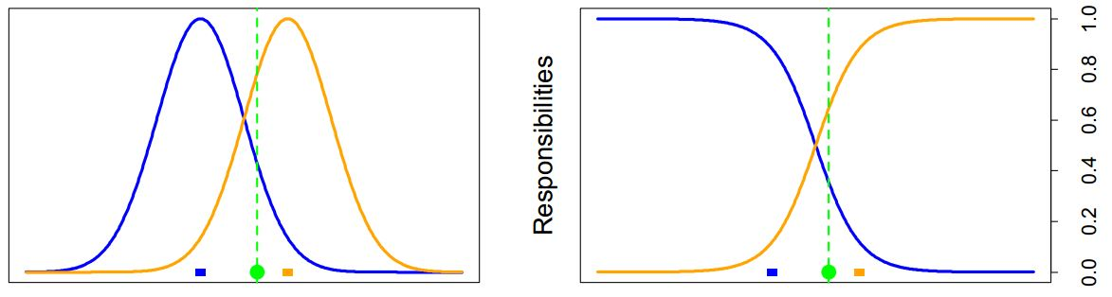
Intuition

Slide 31

A mixture of K Gaussians
A distribution generated by randomly selecting one of K Gaussians, then randomly draw a point from that distribution.
Gaussian k with a probability of p_{k}
Goal: find p_{k}, σ_{k}, m_{k} that maximize the probability of our data points.
Notes:
where g(x; mk, ) indicates the k’th Gaussian distribution, and m and sigma indicate all k
parameters.
Goal : .. this gives a soft assignment to each data point,
since it gives the probability of that point coming from each distribution

Slide 32
Back to EM
Iterative Algorithm
Goal: group some primitives together
Chicken and Egg problem:
Items in group -=> Description of the group
Description Of the group -=> Items in group

Slide 33
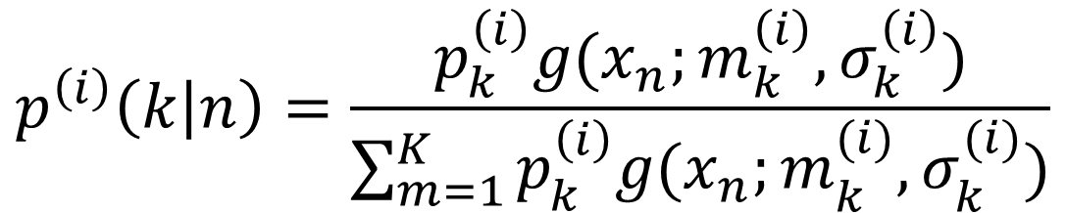
EM
Iterative Algorithm: E Step and M Step
E Step:
Compute the probability that point n is generated by distribution k
Notes:
נחשב את ההסתברות שההתפלגות K היא זאת ש"אחראית" לנקודה N.
we compute the probability that point n is generated by distribution k, and then
normalize this by the probability of all distributions generating it. We can think of this as
softly assigning a point to each distribution, with these probabilities.

Slide 34
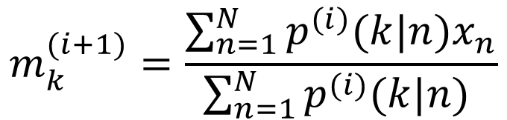
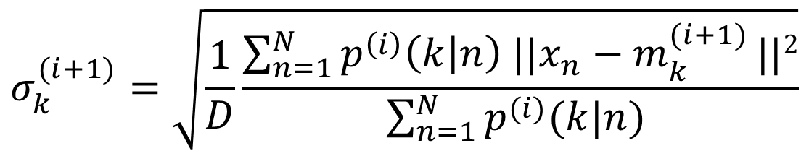
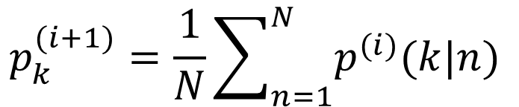
EM
M Step:
Notes:
recompute the parameters of all these distributions, using these
soft assignments.

Slide 35
EM
Converges to a locally optimal solution
Each step increases the probability of the points given the distributions.
Can get stuck in local optima

Slide 36
EM and K-means
Notice the similarity between EM for Normal mixtures and K-means.
The expectation step is the assignment.
The maximization step is the update of centres.
K-means is a simplified EM.
K-means makes a hard decision while EM makes a soft decision when updating the parameters of the model.

Slide 37
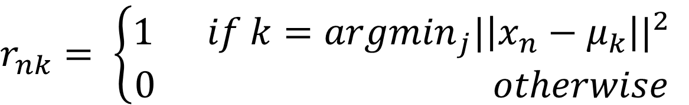
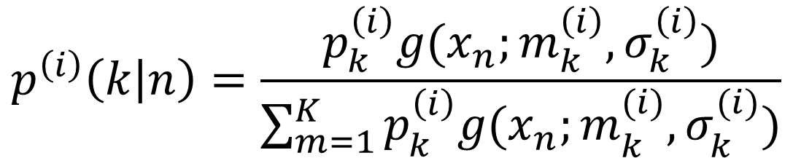

EM and K-Means
K-Means
EM
Notes:
Maximum probability that it belongs = minimum distance to center, so it belongs there…

Slide 38
Final Project
Find a problem your team care about and try to solve it:
1 problem per group! No sub groups
Use Spark or DL
No limit on ML algorithm type
Limit your dataset size to fit in Databricks
Use your own Spark cluster if you want to tackle a real-world big problem.
Presentation:
10 minute each + 5min Q&A
Tell a story, why and how. Not only the graphs and results
Your slides will work as your brief summary as well. (Make it readable, put in notes etc.)

Slide 39
Logistics of presentations
Use Google Slides, Email me a link before class. (No switching laptops!)
Evaluation:
Don't worry about presentation style
but don't make it toooo boring
Technical:
Use of Spark (Or DL)
ML Analysis (Or some technical enhancements to existing sw eco-system)
(Use of graphs, etc)
Tell the full story (why, how, what, etc)

Slide 40
Hands-on

Slide 41
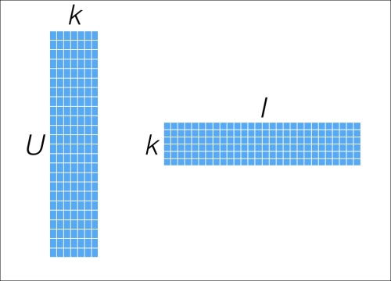
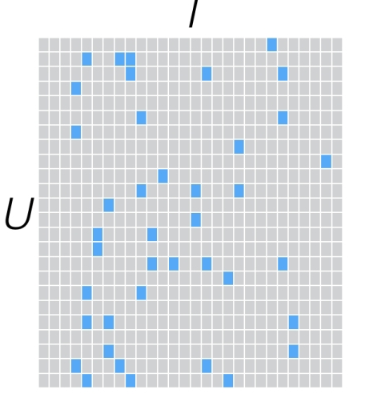
Cluster Movies of MovieLens
R
P^{T}
Q
=
X
Use k features of the items, play with Kmeans and EM

